Slide 1
A Convergence Theory for Deep Learning via Over-Parameterization
Author: Zeyuan Zhu Yuanzhi Li Zhao song
Presenter: Ziniu Hu

Slide 2
Motivation
Observation:
Neural networks (with ReLU activation), trained by ﬁrst-order methods (SGD) from random initialization, can even reach global minimal over training set.
From optimization perspective, NN is non-convex and non-smooth, which should have problems for optimization (saddle points, etc). But in reality it doesn’t have such problems.
Goal, to prove that:
Multi-layer DNN with ReLU activation can be trained close to zero training error using GD or SGD under mild assumption
The running time depend only polynomials in the number of layers.

Slide 3





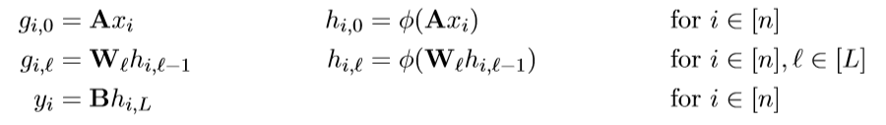



Notation:
Data:
Model
Initialization

Slide 4

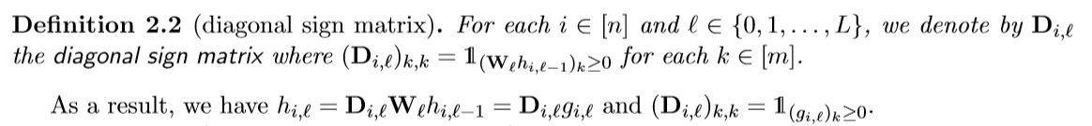
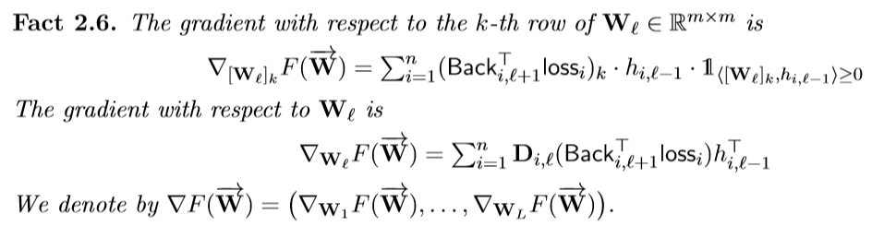
Objective Dunction:
Gradient:

Slide 5
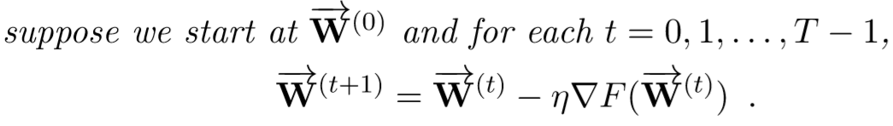
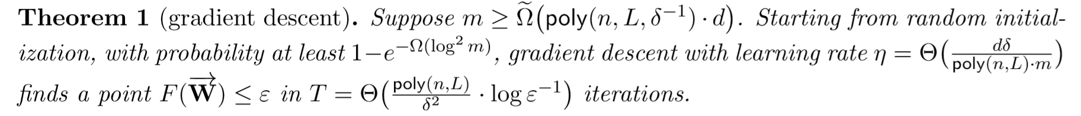
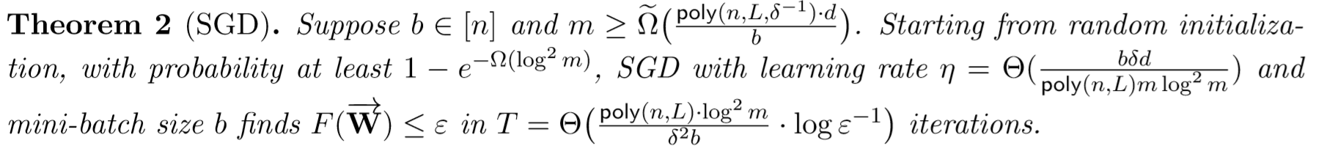
Key Results
This means that, this NN have a linear convergence rate, because ε drops exponentially fast in T.
The same results can be extended to CNN and ResNet, and other losses

Slide 6
Proof RoadMap
Lemma 4
(properties at random initialization)
Lemma 5
(stability after adversarial perturbation)
Theorem 3
(No Critical Point)
Theorem 1 & 2
(Linear convergence rate)
GD & SGD
Lemma 6
(Gradient Bound)
Theorem 4
(Semi- Smothness)

Slide 7
Proof RoadMap
Lemma 4
(properties at random initialization)
Lemma 5
(stability after adversarial perturbation)
Theorem 3
(No Critical Point)
Theorem 1 & 2
(Linear convergence rate)
GD & SGD
Lemma 6
(Gradient Bound)
Theorem 4
(Semi- Smothness)

Slide 8
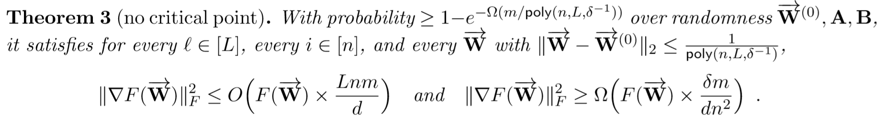
This means that gradient norm is always bounded (no saddle point or critical point)
Can be helpful to find global minima, (if added smoothness)
However, Relu is not twice differentiable, thus need “semi-smoothness”

Slide 9
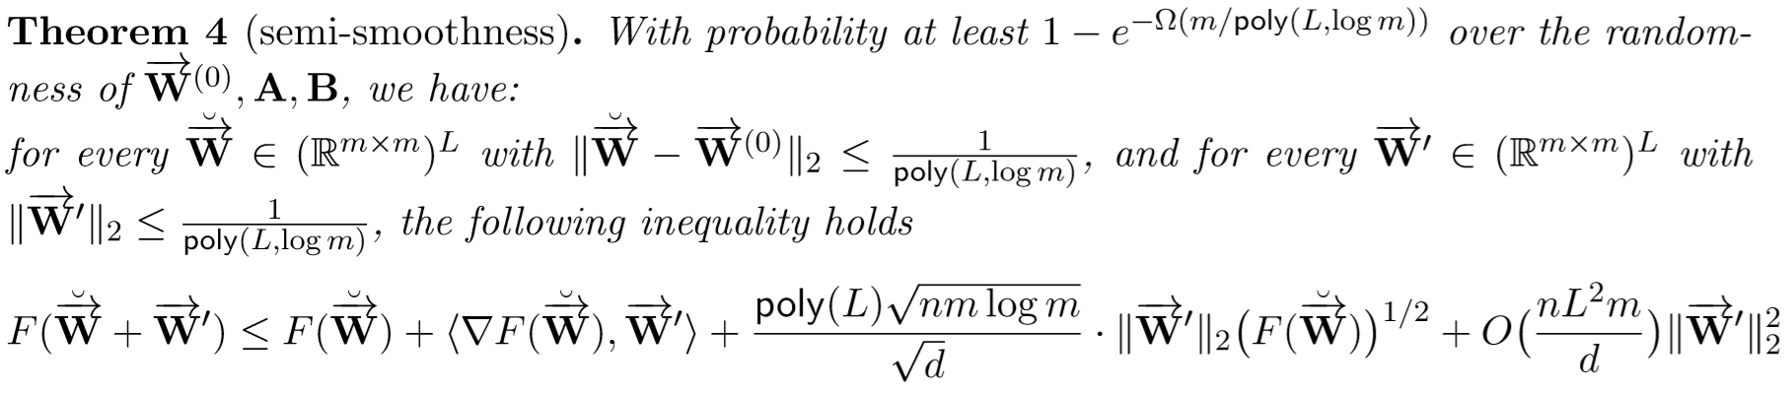

This means that gradient norm is always bounded (no saddle point or critical point)
Can be helpful to find global minima, (if added smoothness)
However, Relu is not twice differentiable, thus need “semi-smoothness”
Different from smoothness, here we have first-order term
As m (model weights) goes larger, (first order term << second-order term), and thus -> smooth.

Slide 10
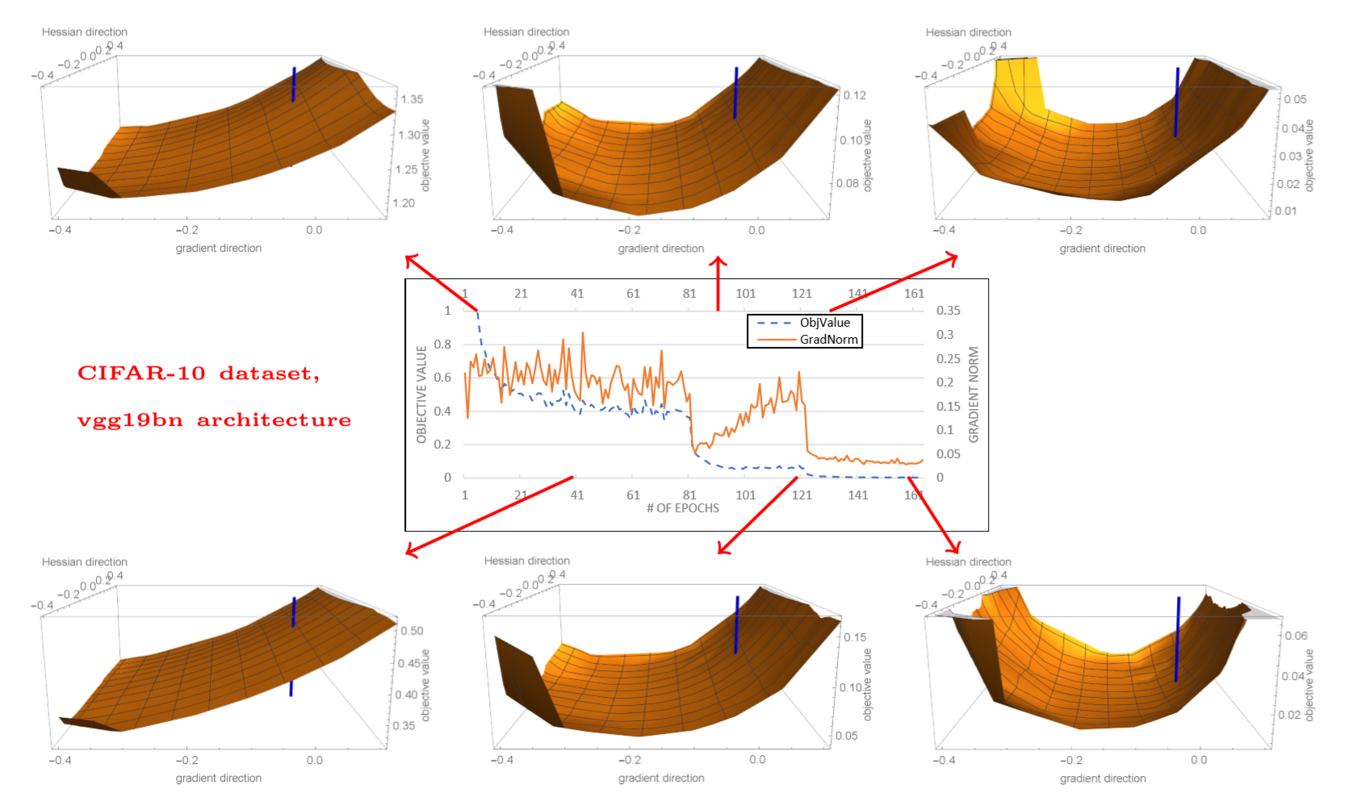
The first-order gradient itself can sufficiently decreases the training objective, second-order information give little help.
Gradient is bounded and the landscape doesn’t have critical points and smooth (Theorem 3&4).

Slide 11
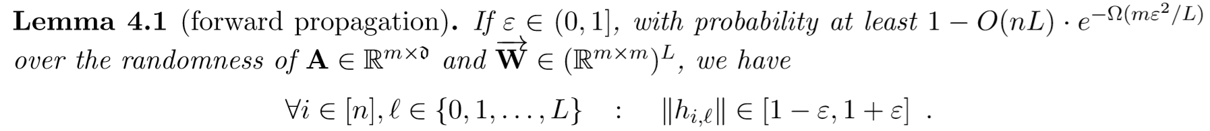

Slide 12

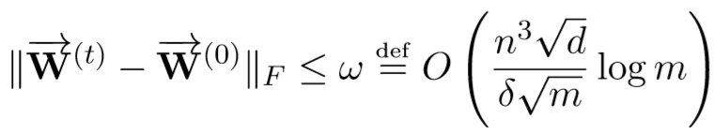

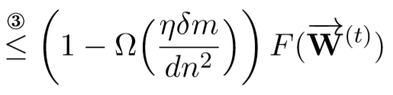
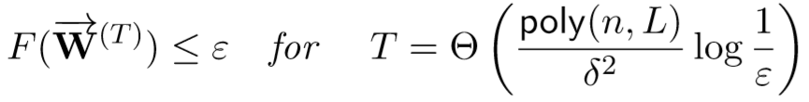
Proof of Theorem 1
Use random initialization to show that initial error is bounded:
Suppose updated weights is not far from initial weights:
Prove that each update can reduce the loss, and thus bound the final loss:

Slide 13
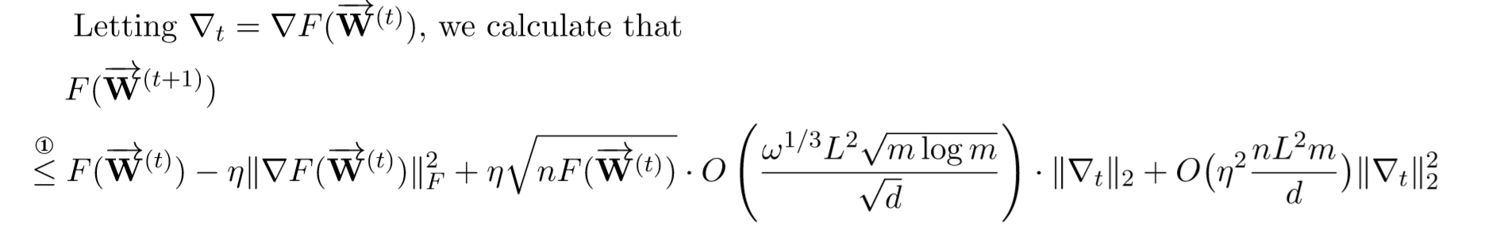
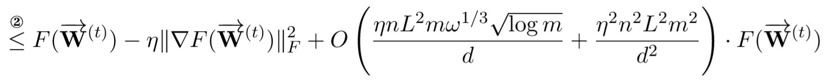

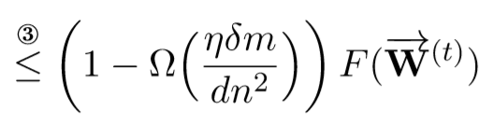
Uses Theorem 4 (Semi-smooth) + initial loss is bounded + updated weights is not far from initial weights
Uses Theorem 3 (No Critical Points)
Uses Gradient lower bound in Theorem 3

Slide 14
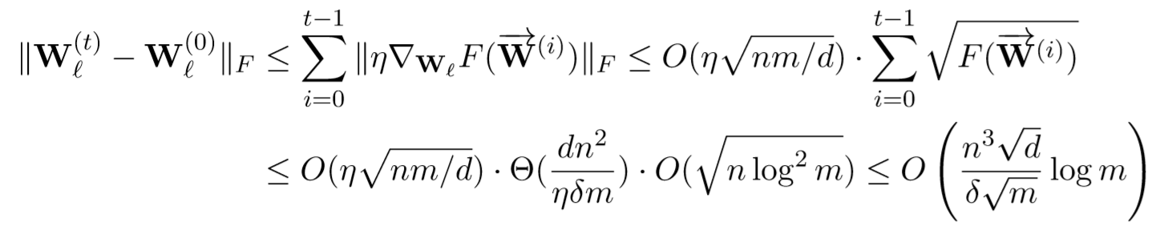


Proof of Theorem 1
Verify that: updated weights is not far from initial weights:
Based on Theorem 3 (No Critical Points):
Proof of Theorem 2 (SGD) is similar, except that we are going to bound
instead of . Can be proved with careful use of
martingale concentration

Slide 15



















Proof RoadMap
Lemma 4
(properties at random initialization)
Lemma 5
(stability after adversarial perturbation)
Theorem 3
(No Critical Point)
Theorem 1 & 2
(Linear convergence rate)
GD & SGD
Lemma 6
(Gradient Bound)
Theorem 4
(Semi- Smothness)

Slide 16
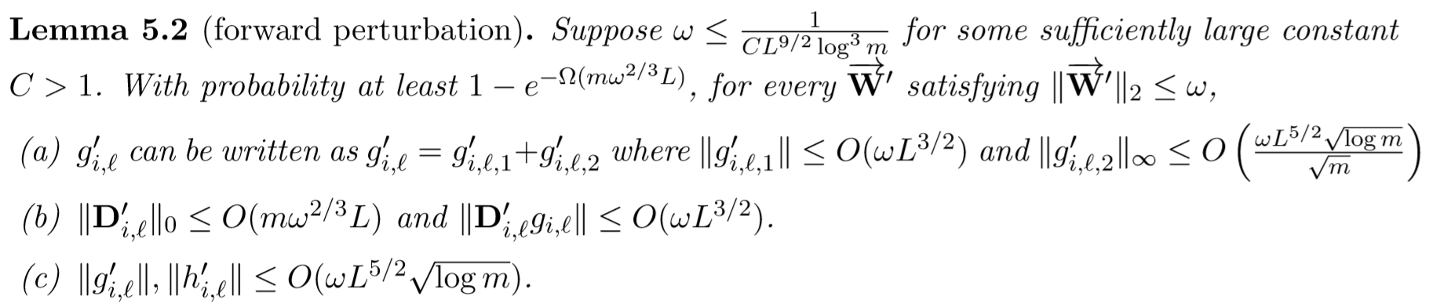
Stability against Adversarial Weight Perturbations
If W is “close” to initialization, then:
The number of sign changes is bounded
The activation changes is bounded

Slide 17
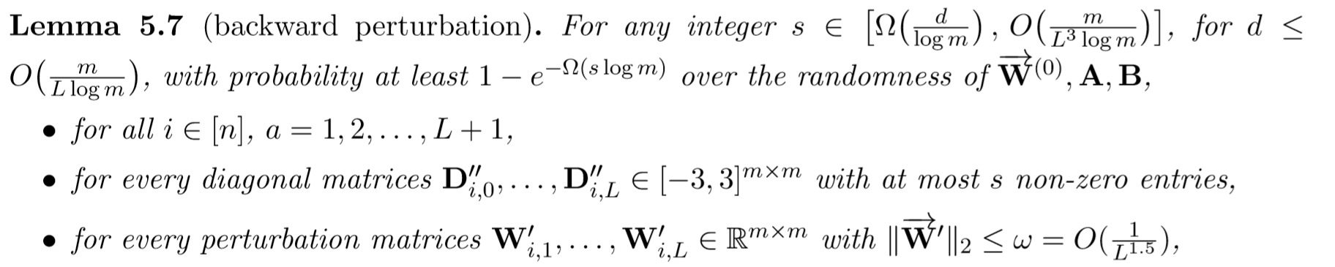
Stability against Adversarial Weight Perturbations
If W is “close” to initialization, then:
The number of sign changes is bounded
The activation changes is bounded

Slide 18
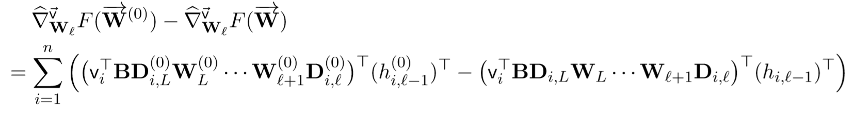
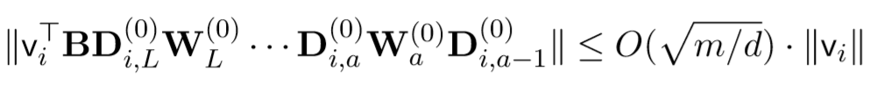
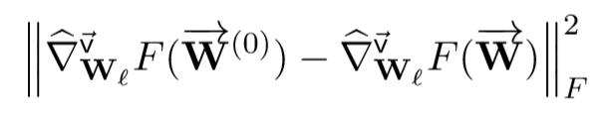
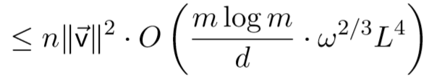
Use Lemma 5.2 (forward perturbation):
Use Lemma 5.7 (backward perturbation):
Use Lemma 4.1 & 4.4b & 5.2c (forward and backward activation is bounded):

Slide 19
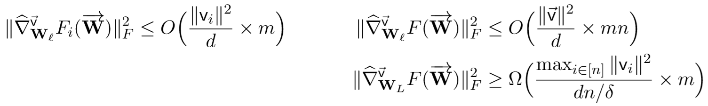
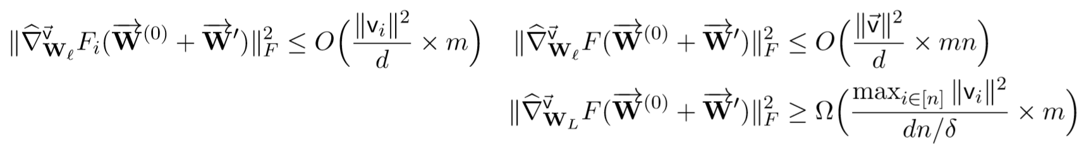
Use Lemma 6.3 (Initial gradient is bounded):

Slide 21
Proof RoadMap
Lemma 4
(properties at random initialization)
Lemma 5
(stability after adversarial perturbation)
Theorem 3
(No Critical Point)
Theorem 1 & 2
(Linear convergence rate)
GD & SGD
Lemma 6
(Gradient Bound)
Theorem 4
(Semi- Smothness)

Slide 22
Use Lemma 5.2 (forward perturbation):
Use Lemma 5.7 (backward perturbation):
Use Lemma 4.1 & 4.4b & 5.2c (forward and backward activation is bounded):

Slide 23
Prove that at any W, and perturb it to be W’, bound how much the objective change in second and higher order terms.
As the activation perturbation is bounded, this along with other small tricks, we can prove the theorem.
This conclusion is similar to composition of Lipschitz, so that the amount of changes to each hidden layer is proportional to changes in weights.

